Slide 1

INTELLIGENT CONTROL OF AC SERVO-MOTOR USING NEURAL NETWORKS
ALI AYMAN
SALMA ESSAM

Slide 2
CONTROL SCHEMES OVERVIEW:
Scalar Control: Maintains fixed voltage-frequency ratio but lacks precise speed control.
Vector Control (FOC): Controls magnetizing and torque-producing components independently for speed and torque regulation.
Direct Torque Control (DTC): Decouples torque and flux for independent control with faster torque response.

Slide 3
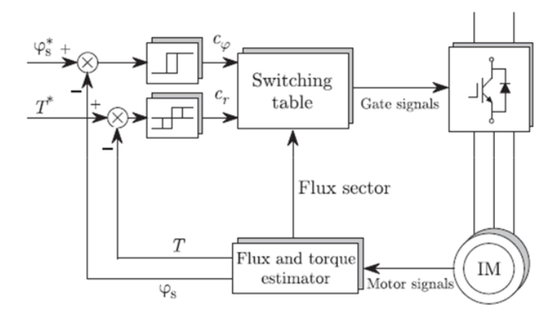
DTC OVERVIEW
TORQUE AND FLUX COMPARATORS ENSURE THAT TORQUE AND FLUX VALUES REMAIN WITHIN NARROW HYSTERESIS BANDS
AN OPTIMUM PULSE SELECTOR DETERMINES THE VOLTAGE VECTOR BASED ON TORQUE AND FLUX STATUS SIGNALS, GUIDED BY A LOOKUP TABLE
DTC EMPLOYS TWO CONTROL LOOPS: SPEED CONTROL AND TORQUE CONTROL

Slide 4
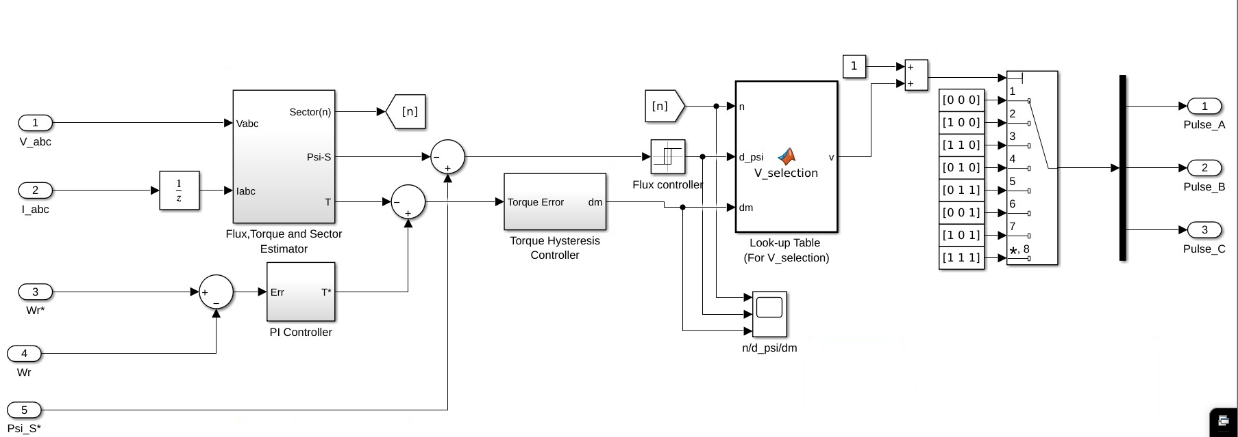
BENCHMARK
In our study, traditional Direct Torque Control (DTC) stands out as the benchmark

Slide 5
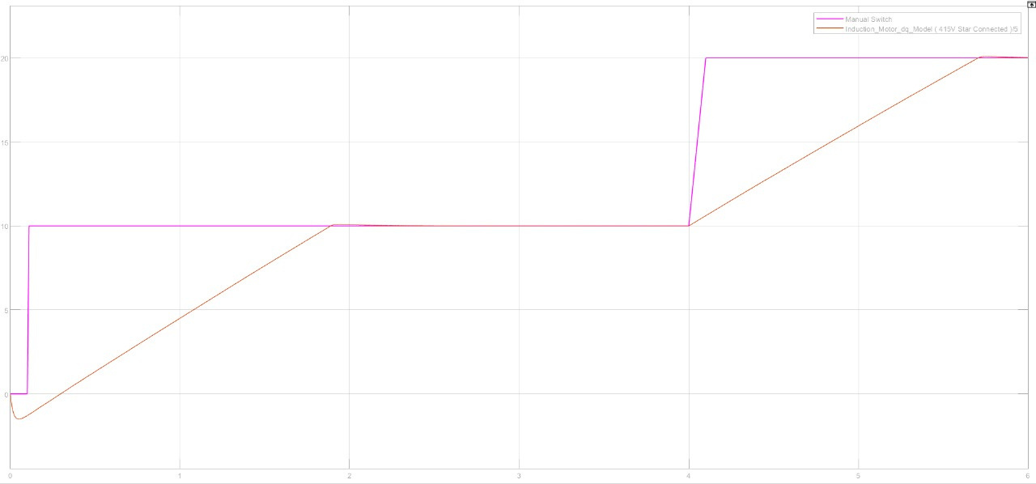
RESULTS OF DTC
DTC OFFERS SUPERIOR PERFORMANCE WITH FAST TORQUE RESPONSE AND PRECISE CONTROL COMPARED TO TRADITIONAL METHODS.
omega motor compared to the reference value

Slide 6

ARTIFICAL
NEURAL NETWORKS

Slide 7
CONTROL TECHNIQUES
TRADITIONAL CONTROLLERS LIKE PID AND LQR REQUIRE ACCURATE MATHEMATICAL MODELS OF THE SYSTEM DYNAMICS.
HOWEVER, BUILDING ACCURATE MODELS IS CHALLENGING DUE TO VARIOUS FACTORS SUCH AS UNCERTAINTY, AND PARAMETER DRIFTS.
NEURAL NETWORKS OFFER AN INHERENT STRUCTURE SUITABLE FOR MAPPING COMPLEX CHARACTERISTICS, LEARNING, AND OPTIMIZATION.

Slide 8
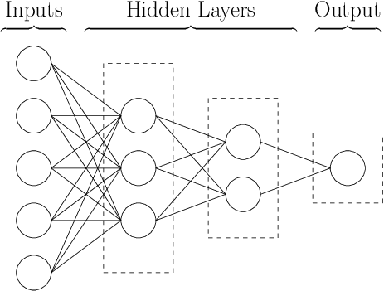
ANN OVERVIEW
1
Researchers propose Artificial Neural Network (ANN) as an optimal choice for controller design, highlighting its potential for superior and highly precise control responses, especially in a field such as modern electric drives.
2
The key feature of ANN lies in its novel structure for information processing, enabling it to emulate the complexities of biological neural networks.
3
A Neural network is a kind of continuous-time dynamic system with high nonlinearity and good learning ability

Slide 9
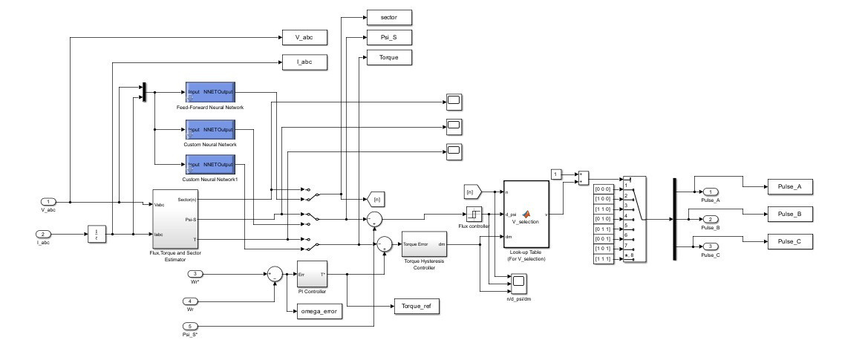
RESULTS OF ANN
The primary objective was to substitute the torque and flux sector estimator block, which harbors significant nonlinearity owing to the equations utilized, with a Neural Network.

Slide 10
SECTOR ANN
Only activating the Sector ANN

Slide 11
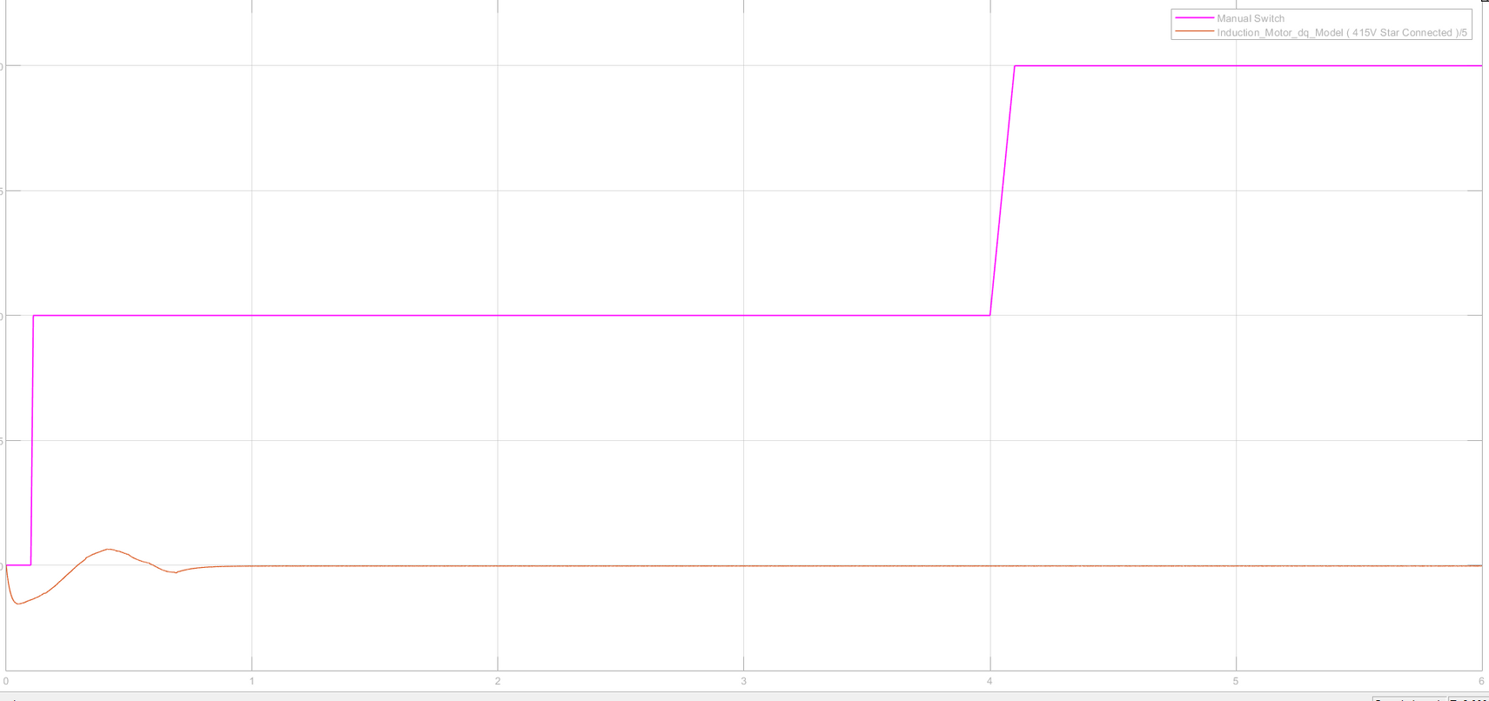
FLUX ANN
Only activating the Psi ANN

Slide 12
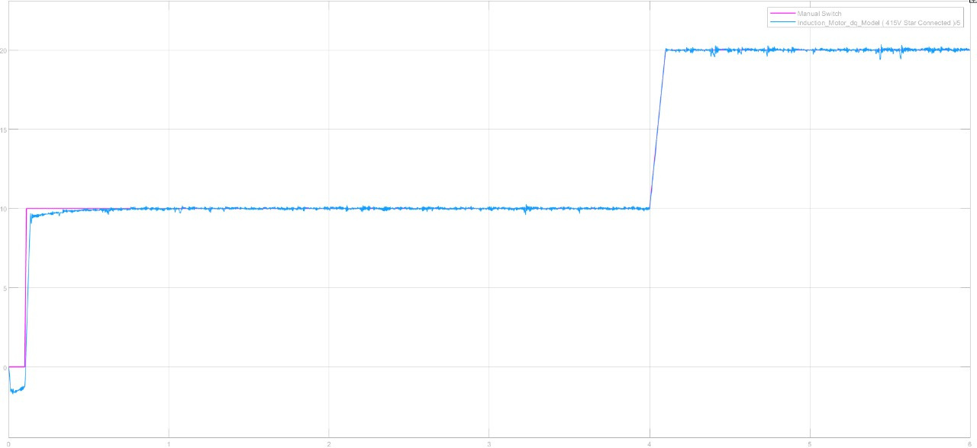
TORQUE ANN
Only activating the Torque ANN

Slide 13

LONG SHORT TERM MEMORY

Slide 14
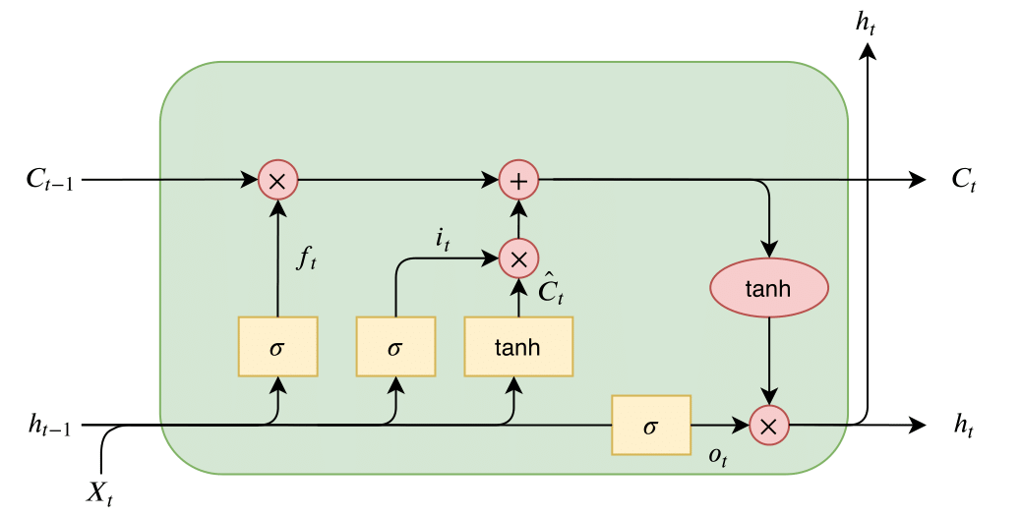
RNNs face challenges in learning long-term dependencies due to the limitation of having only one hidden state transferred through time.
1
LSTMs address this issue by introducing memory cells that can store information for extended periods, making them ideal for tasks like time series forecasting.
LSTMs employ three gates—the input gate, forget gate, and output gate—to control the flow of information within the memory cell. The input gate determines what data is added to the memory cell, the forget gate manages data erasure, and the output gate regulates the data output from the memory cell.
2
3

Slide 15
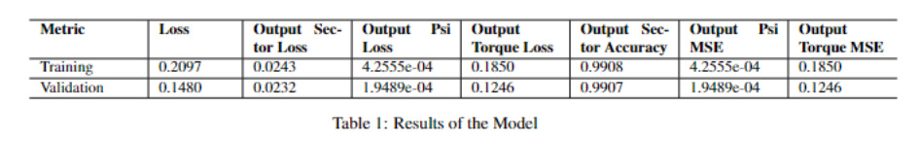
RESULTS OF LSTM
Due to time constraints, actual simulation results of LSTM implementation were not obtained.However, preliminary evaluation of the model showed promising performance based on the following values for loss functions.

Slide 16
CONCLUSION AND FUTURE WORK
Artificial Neural Network (ANN) outperforms traditional Direct Torque Control (DTC) method for torque estimation.
ANN excels in learning from data and rapidly adjusting its estimates.
Although Long Short-Term Memory (LSTM) shows even better performance, time constraints led to the selection of ANN.
Further experimentation and validation are recommended to fully assess the performance and applicability of the LSTM model in the given context.

